Slide 1
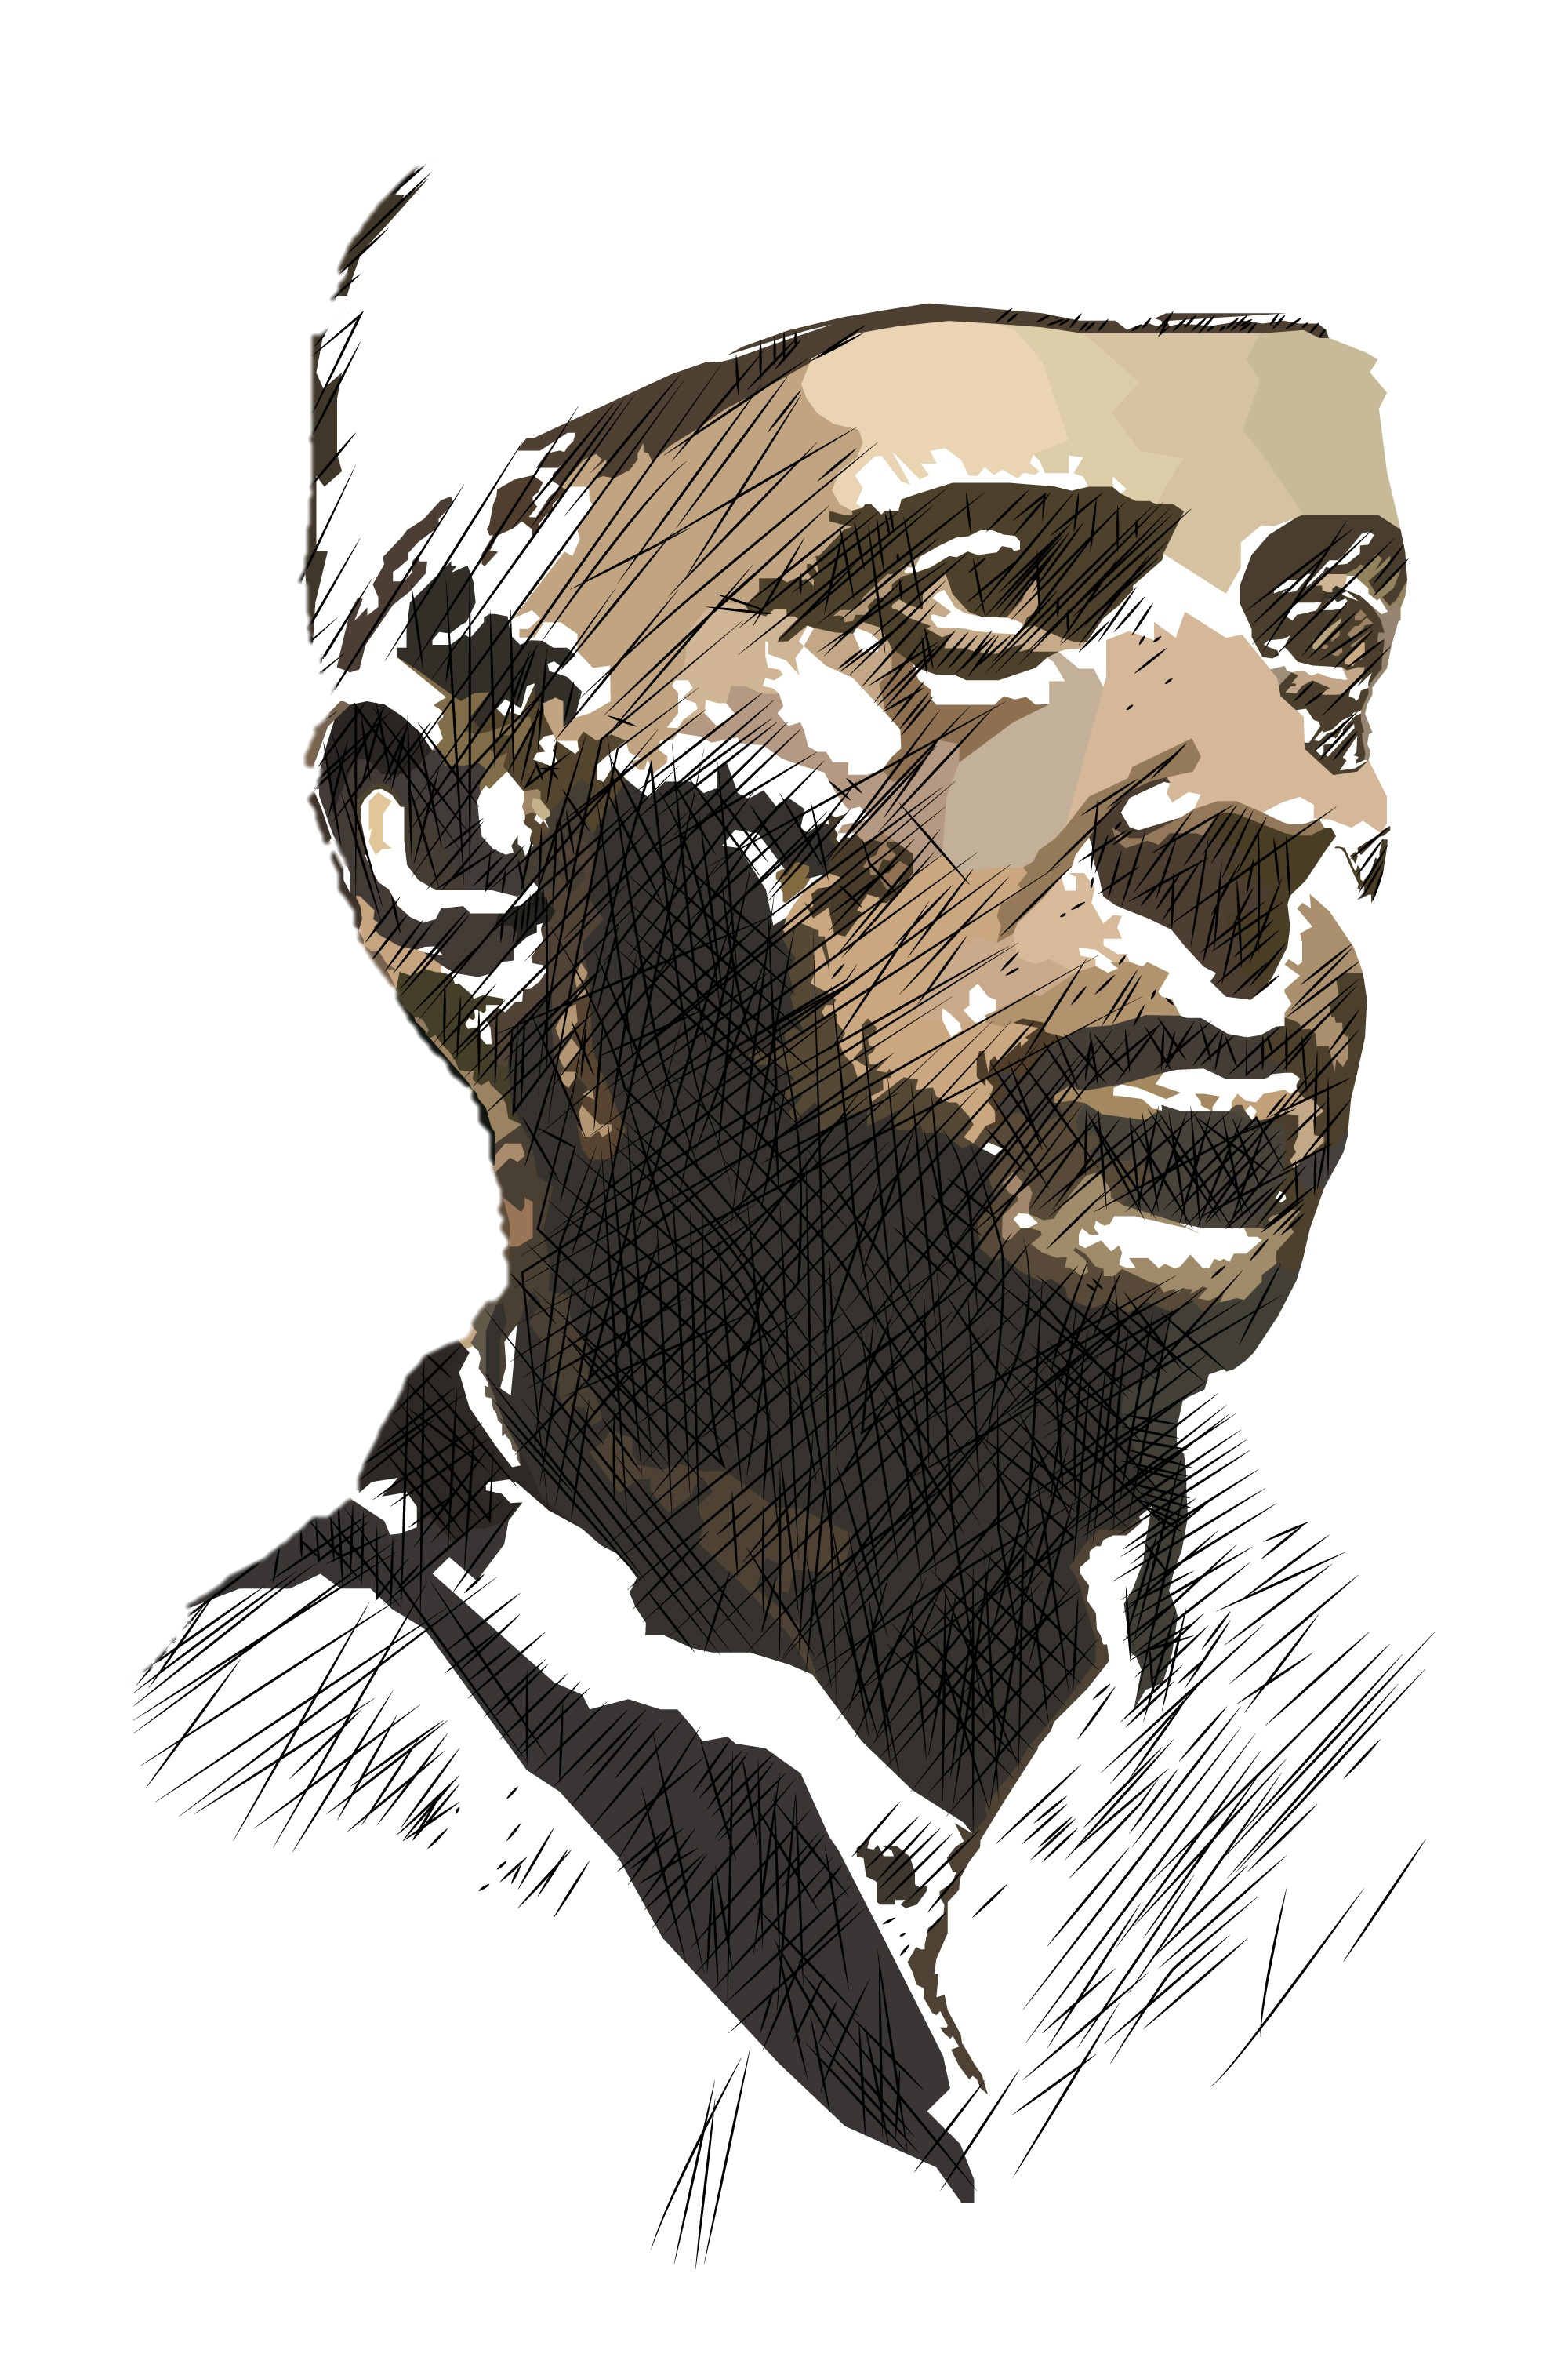

Slide 2

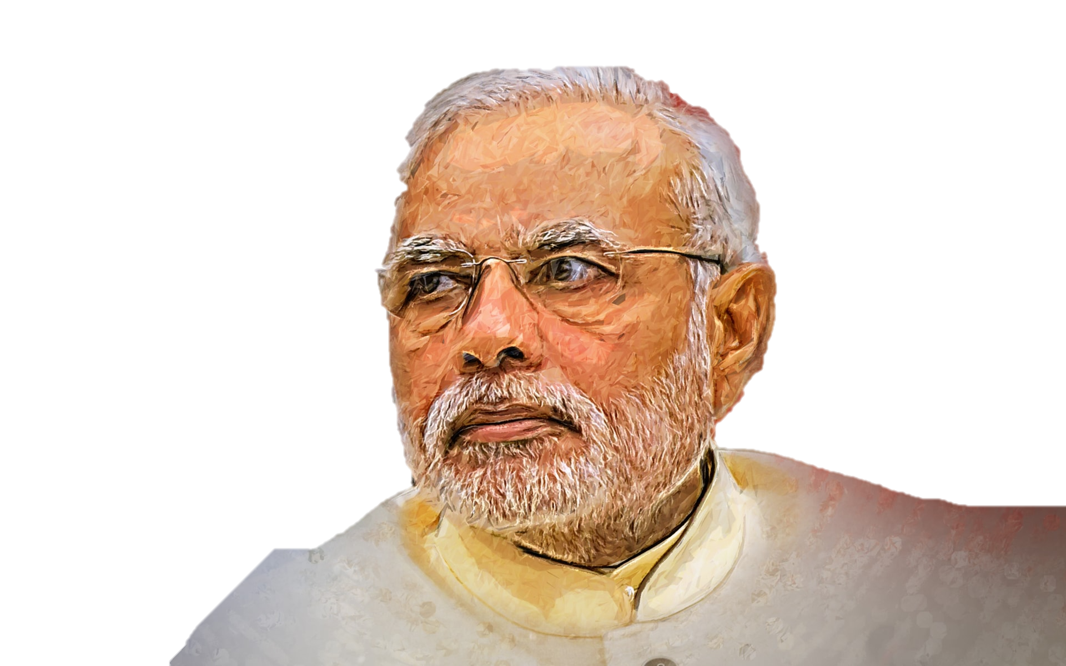

Slide 3
https://www.wallpaperuse.com/vien/ooxoRh/
https://pixy.org/5912282/
https://commons.wikimedia.org/wiki/File:India-flag.svg

